Slide 1
CAUSE, EFFECT & RISK CONTROL MEASURES

Slide 2
CORONAVIRUS/COVID19 RETURNING TO WORK
Scottish Government &
Construction Industry Guidance.

Slide 3
COVID-19: GENERAL INFORMATION
Coronavirus affects travel, parking, entering sites, walking routes, welfare cabins, briefings, employees, sub-contractors, visitors, delivery drivers, cleaning, first aid & emergency arrangements.

Slide 4
COVID-19: CAUSE
Highly infectious virus spread in droplets from sneezing & coughing, passing directly to another person or indirectly by touching surfaces, contaminated with droplets.
The virus can remain on surfaces for up to 72 hours.
The virus gets into the body through the eyes, nose & mouth, by people touching their face with their hands.

Slide 5
COVID-19: EFFECT
Principally affects the lungs and airways, but can also cause fever, raised temperature, a new continuous dry cough, headache, aching muscles and fatigue.
People experience a range of symptoms from mild discomfort to severe effects - that can lead to death.

Slide 6
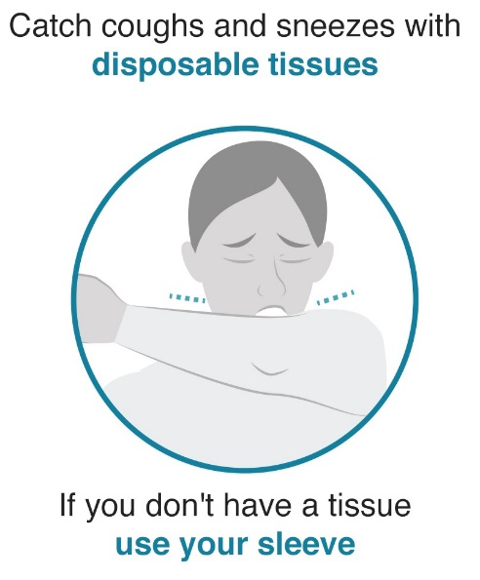
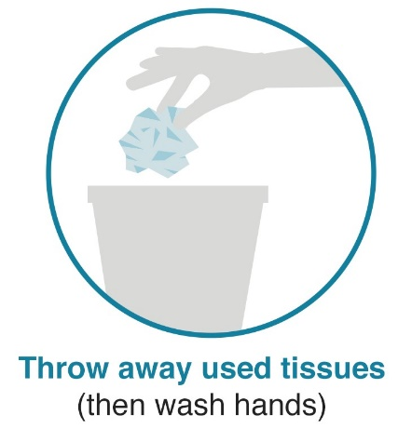
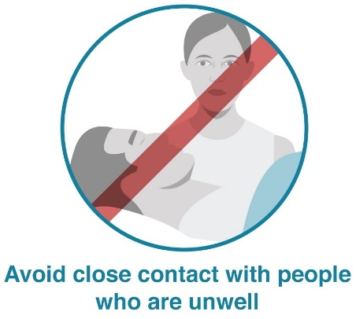
COVID-19: RISK CONTROLS: GOOD HYGIENE PRACTICE
DO
AVOID

Slide 7
COVID-19: RISK CONTROLS: GOOD HYGIENE PRACTICE
Hand washing is the priority with hand sanitiser as a back up
Use disinfectant / antiseptic wipes to regularly clean surfaces;
Tables/Desk, Tools, Door handles, All contact/touching points etc.
Avoid transmitting the virus to surfaces which could be picked up by others
Everyone has a responsibility to prevent the spread of the virus & assist in finding solutions

Slide 8
COVID-19: RISK CONTROLS: GOOD HYGIENE PRACTICE
FIRST AIDERS
First aid kit to include extra PPE for First Aiders, being; face mask, disposable gloves, apron & eye protection.
If giving CPR - only do chest compressions

Slide 9
COVID-19: RISK CONTROLS: SOCIAL DISTANCING
Keep a safe distance of 2m from each other at all times
If you know of times when this cannot be achieved or is being ignored, you must bring to the attention of site management.
Working together, solutions should be sought by everyone eliminate and reduce this close contact.

Slide 10
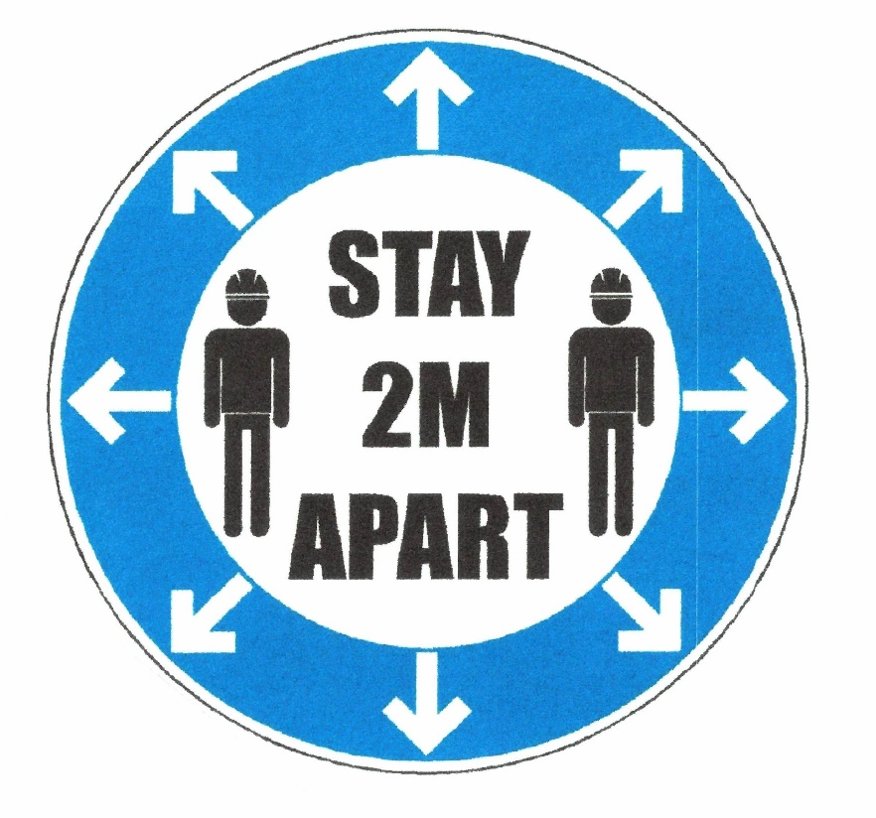
COVID-19: RISK CONTROLS: SOCIAL DISTANCING
Points of common contact removed if possible
access, cabins, points of work, vehicles etc.
Signs & markings to support the above
Staggered breaks
Bring a packed lunch, refreshments (flask)
Restricted numbers in welfare cabins
Keep 2m apart – all areas;

Slide 11
COVID-19: RISK CONTROLS: COMMUNICATION
Comply with hygiene & social distancing requirements
Briefing numbers will be reduced in welfare cabins
Rotational shifts required for briefings – staggered times
Squads kept together as much as possible
Look for signs/markings
Wash hands – use hygiene stations
COVID risk controls included in every task briefing
Avoid inviting non-essential visitors to site.

Slide 12
COVID-19: RISK CONTROLS: MONITORING
Self Monitor: Always be vigilant - a personal responsibility
COVID Monitors appointed on site to;
Coach/remind persons of requirements
Raise issues of repeated non-compliance

Slide 13
COVID-19: RISK CONTROLS: MONITORING
If displaying symptoms persons must report to management & isolate for 7 days
If a member of the household has symptoms they must isolate for 14 days.
If in doubt – contact management.
As we all adapt to the “NEW NORMAL” at work, any improvement suggestions from the workforce are encouraged and welcomed. If you have an improvement suggestion, please bring this to the attention of the COVID Monitor.

Slide 14
COVID-19: RISK CONTROLS:
THIS RISK IS SERIOUS
Site monitoring will be carried out with a focus on COVID controls:
Continuous daily inspections
Site Management & Senior Management reports
Health & Safety inspections & audits
Directors tours
Link to Scottish Government website:
https://www.gov.scot/coronavirus-covid-19/

